Slide 1

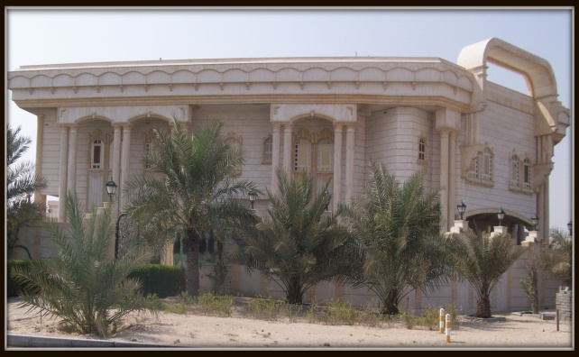
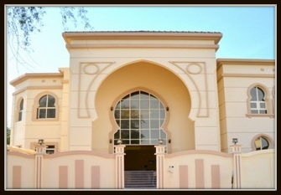

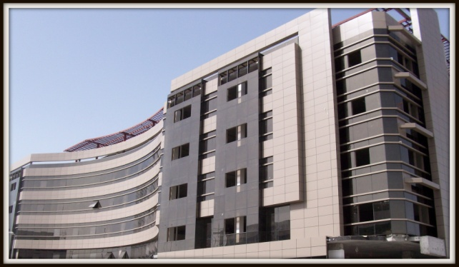
Company profile

Slide 2
Introduction
Established by Mr.Mohammed Obied Bushaqer, who owns the company.
The company was set up 40 years ago (1977) under the name of ABU SHAQER CONTRACTING L.L.C, the name has been changed recently to become BENAA AL MOSTAQBAL CONTRACTING L.L.C.
We have included M.E.P division to our company’s trade license for electro-mechanical work.

Slide 3
Policy
The policy of the company can be determined as:
Completion of the project on time.
Quality of Construction to be maintained in every sphere of the work.
The use of quality products & fixtures.
Guaranteed exceptional quality for clients and investors with time deadlines and within budgets.
The company has executed a number of projects for private owners such as towers, commercial buildings and villas.

Slide 4
Mission
Committed to building most advanced and superior value for our clients and investors, accomplish lucrative financial returns for our company and build mutual positive relationships for clients, investors, employee, suppliers, sub – contractors and the society whom we need to do business.

Slide 5
Vision
BENAA AL MOSTAQBAL CONTRACTING is not just a construction company. But a dedicated team motivated to bring contribution to our society and assisting our clients and investors in making their dreams come true.

Slide 6
General Manager
Administration
Projects
Secretary
Accounts
Drivers
Office Clerks
Purchase
Project Manager
Civil
Electrical
HVAC
Plumbing
Foreman
Painters
Masons
Carpenters
Safety Officer
Chairman
ORGANIZATION CHART

Slide 7
List of Consultants Worked With:
Darton Engineerng Consultant.
Pioneer of Expert.
House of Expert Engineering Consultant.
Citi Consult.
Gulf Engineering Consultant.
New Ark Engineering Consultant.
Al Gaith for Designing & Consulting.
Al Safeer Engineering Conusltant
Kasia Engineering Consultant.
Ramish & P Cartners.
Red Crystal Engineering Consultant.
New Tech Engineering Consultant.
Construction Corner.
Al Muajssam Engineering Consultant.
Al Abbassi Engineering Consultant.

Slide 8
List of completed projects:
Project | G + M + 3 (Phase one)
Location | Al Qarhoud
Client | Mr, Mohammed Obied Bushaqer
Consultant | Pioneer
Completed year | 16 months
Project | 12 Villas + G + Basement + Service Room
Location | Mirdif
Client | Mr, Mohammed Obied Bushaqer
Consultant | House of expert Consultant
Completed year | 16 months

Slide 9
List of completed projects:
Project | 5 Villas + G +1 + Basement + S/Pool
Location | Mizher 2
Client | Mr, Mohammed Obied Bushaqer
Consultant | Dartin Engineering Consultant
Completed year | One year
Project | Villa + G + Service Room
Location | Muhaisanah 1st
Client | Mr, Jaber Hassn Mohd Yousef Al Jaberi
Consultant | House of expert Consultant
Completed year | One year

Slide 10
List of completed projects:
Project | Labour Accommodation G + 2
Location | Dubai Investment Park 1st
Client | Mr, Galadari Investment L.L.C
Consultant | Citi Consult
Completed year | One year
Project | Labour Accommodation G + 2
Location | Muhaisanah 2nd
Client | Mr, Omar Mohd Obied Bushaqer
Consultant | House of Expert Engineering Consultant
Completed year | One year

Slide 11
List of completed projects:
Project | Facility Building G + M
Location | Al Qusais Industrial 5th
Client | Mr, Mohmmed Obied Bushaqer
Consultant | Pioneer Engineering Consultant
Completed year | 5 months
Project | Villa G + 1 + Majlis
Location | Al Barsha 3rd
Client | Mrs, Ibtesam Mohd Ahmed Atiq Al Mahiri
Consultant | Pioneer Engineering Consultant
Completed year | One year

Slide 12
List of completed projects:
Project | Labour Accommodation G + 2
Location | Dubai Investment Park 1st
Client | Mr, Galadari Investment L.L.C
Consultant | Citi Consult
Completed year | One year
Project | Villa G + 1 + Majlis
Location | Mezhir 1st
Client | Mr, Abdul Rahman Saad Mohd Al Faheed
Consultant | New ark Engineering Consultant
Completed year | One year

Slide 13
List of completed projects:
Project | Villa + G + Service Room
Location | Mezhir 1st
Client | Mr, Rashid Khalifah Belhoul Al Muheri
Consultant | House of Expert Engineering Consultant
Completed year | One year
Project | Villa + G + Service Room
Location | Mirdif
Client | Mr, Khalid Jaafar Ali Hassan
Consultant | Al Gaith for Designing & Consulting
Completed year | One year

Slide 14
List of completed projects:
Project | Villa G + 1 + Majlis
Location | Al Khawanij Residence
Client | Mr, Hassan Adbullah Noor AL Darai
Consultant | Kasia Engineering Consultant
Completed year | One year
Project | Villa G + 1 + Majlis
Location | Mirdif
Client | Mr, Mohd Jomaa Abdullah Mohd
Consultant | Ramish & Partners
Completed year | One year

Slide 15
List of completed projects:
Project | Villa G + 1 + Majlis + Swimming Pool
Location | Muhaisanah 1st
Client | Mr, Mohd Baqir Ali Al Hashemi
Consultant | Red Crystal Engineering Consultant
Completed year | One year
Project | Villa G + 1 + Majlis + Service Room
Location | AL Khawanij Residence
Client | Mr, Rashid Belhoul
Consultant | New tech Engineering Consultant
Completed year | One year

Slide 16
List of completed projects:
Project | Villa G + 1 + Majlis + Service Room
Location | Mizher 1st
Client | Mr, Ahmed saeed Khalifa Bin Ghalitah
Consultant | Construction Corner
Completed year | One year
Project | Villa G + 1 + Majlis + Service Room
Location | Muhaisanah 1st
Client | Mr, Aref Mohd Obied Bushaqer
Consultant | Al Mujassam Engineering Consultant
Completed year | One year

Slide 17
List of completed projects:
Project | Villa G + 2 + Majlis + Service Room
Location | Al Qouz 1st
Client | Mrs, Salwa Belal fairouz
Consultant | Citi Consult
Completed year | One year
Project | G + M + 3 (Phase Two)
Location | Al Qarhoud
Client | Mr, Mohammed Obied Bushaqer
Consultant | Pioneer
Completed year | 16 months

Slide 18
List of completed projects:
Project | Villa G + 1 + Majlis
Location | Al Khawanij Residence
Client | Mr, Ahmed Abdul Rahman Al Hamadi
Consultant | Pioneer Engineering Consultant
Project | Villa G + 1 + Majlis
Completed year | One year
Project | Villa G + 1 + Majlis
Location | Al Tawar 3rd
Client | Mr, Hassan Darwish
Consultant | Citi Consult
Project | Villa G + 1 + Majlis
Completed year | One year

Slide 19
List of completed projects:
Project | Villa G + 1 + Majlis + Swimming Pool
Location | Khawanij Farm (Wadi Al Amardi)
Client | Mr, Abdullah Darwish
Consultant | Citi Consult
Project | Villa G + 1 + Majlis + Swimming Pool
Completed year | One year
Project | Villa G + 1 + Majlis + Service Room
Location | Al Warqaa 1st
Client | Mr, Abdulla Mohd Abul Rahman Al Rais
Consultant | Al Abbassi Engineering Consultant
Project | Villa G + 1 + Majlis + Service Room
Completed year | One year

Slide 20
List of completed projects:
Project | Villa G + 1 + Service Room
Location | Al Barsha 2nd
Client | Mr, Mohd Ali Habib
Consultant | Citi Consult
Project | Villa G + 1 + Service Room
Completed year | Five Months
Project | 4 Villas G + 1 + Swimming Pool + CW
Location | Umm Suqueem, 1st
Client | Mrs. Haifa Abdulla Mohammad Saleh
Consultant | Citi Consult
Project | 4 Villas G + 1 + Swimming Pool + CW
Completed year | One Year

Slide 21
List of completed projects:
Project | Villa G + 1 + Majlis + Service Room
Location | Al Khawanij 1st
Client | Mr, Ibrahim Abdul Khaliq
Consultant | Citi Consult
Project | Villa G + 1 + Majlis + Service Room
Completed year | One Year
Project | Ready Mix Manufacturer
Location | Jebel Ali Free Zone
Client | Mr, Ziad Abdulla Ibrahim Galadari
Consultant | Gulf Engineering Consultant
Project | Ready Mix Manufacturer
Completed year | One Year

Slide 22
List of completed projects:
Project | Villa G + 1 + Service Room
Location | Al Khawanij 1st
Client | Mr, Ali Mohd Obied Bushaqer
Consultant | Leader of Expert Engineering & Consultling
Project | Villa G + 1 + Service Room
Completed year | One Year
Project | Labor Camp Accommodation (2)
Location | DIP
Client | Mr, Galadari Investments Co.LLC
Consultant | Citi Consult
Project | Labor Camp Accommodation (2)
Completed year | One Month

Slide 23
List of completed projects:
Project | Villa G + 1
Location | Nedd Al Shebba 4th
Client | Mr, Humaid Ali Abu Al Ressh Al Mansoori
Consultant | Citi Consult
Project | Villa G + 1
Completed year | One Week
Project | Villa G+1 ( Star Bucks)
Location | Jumeira 1st
Client | Mr, Amsaf Investments
Consultant | Citi Consult
Project | Villa G+1 ( Star Bucks)
Completed year | One Month

Slide 24
List of ongoing projects:
Project | Villa G + 1
Location | Nedd Al Shebba 1st South
Client | Mr, Jasim Al Shummari
Consultant | Citi Consult
Project | Villa G + 1
Project | IMPZ 24 2Basement + G+4
Location | IMPZ Tecom
Client | Mr, Ziad Abdulla Ibrahim Galadari
Consultant | Citi Consult
Project | IMPZ 24 2Basement + G+4

Slide 25
List of ongoing projects:
Project | IMPZ 25 2Basement + G+4
Location | IMPZ Tecom
Client | Mr, Ziad Abdulla Ibrahim Galadari
Consultant | Citi Consult
Project | IMPZ 25 2Basement + G+4
Project | Villa G + 1 + Guard Room + Service Block
Location | Al Khawanij 2nd
Client | Mr, Fahed Abdul Rahman Essa
Consultant | Citi Consult
Project | Villa G + 1 + Guard Room + Service block

Slide 26
List of ongoing projects:
Project | Labor Camp Accommodation (3)
Location | DIP
Client | Mr, Galadari Investments Co.LLC
Consultant | Citi Consult
Project | Labor Camp Accommodation (3)
Project | Villa G + 1
Location | Al Khawanij 1st
Client | Ms Shahraban Ibrahim Ali Al Saffar
Consultant | Klick Engineering Consultant
Project | Villa G + 1

Slide 27
List of ongoing projects:
Project | Villa G+1 + Guard Room + Service Block
Location | Al Khawanij 1st
Client | Mr. Abdullah Mohammed Kadfoor
Consultant | Citi Consult
Project | Villa G+1 + Guard Room + Service Block
Project | 16 Villas G+1
Location | Mirdif
Client | Mr, Amsaf Investments
Consultant | Citi Consult
Project | 16 Villas G+1

Slide 28
List of ongoing projects:
Project | 19 Villas G+1
Location | Mirdif
Client | Mr, Ibrahim Al Mulla
Consultant | Citi Consult
Project | 19 Villas G+1
Project | Villa G + 1
Location | Mamzar
Client | Mrs, Amina Ahmad
Consultant | Al Safeer
Project | Villa G + 1

Slide 29
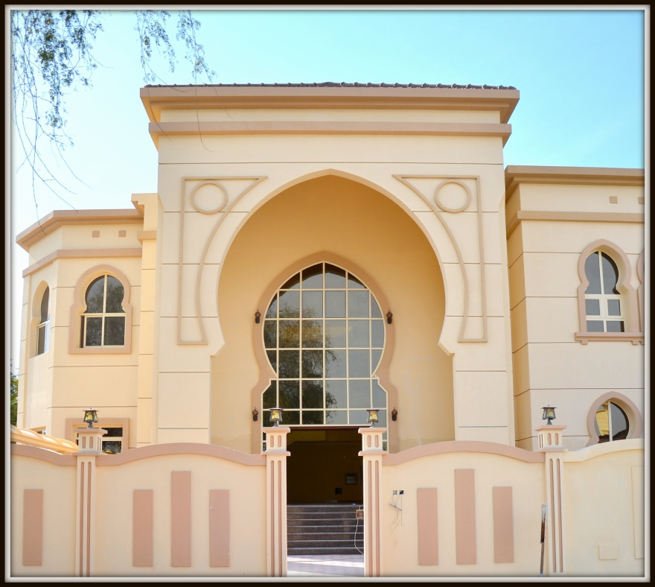
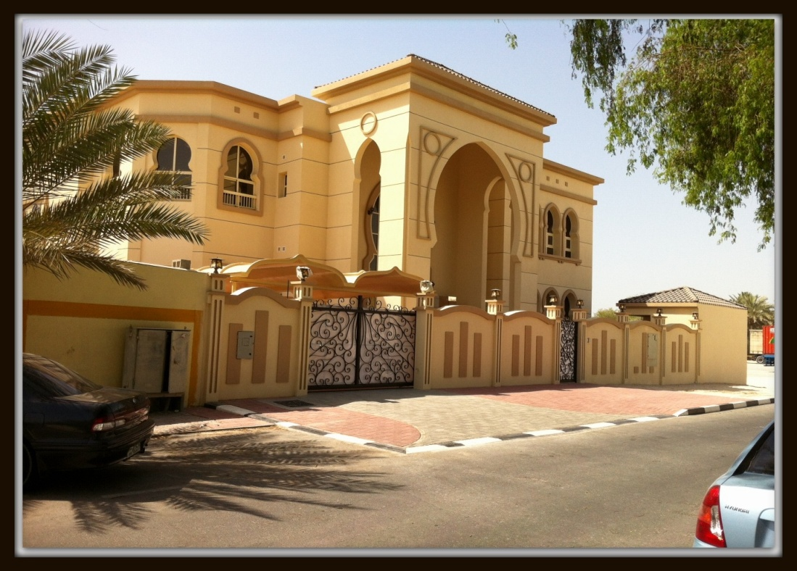
Project Photos:

Slide 30
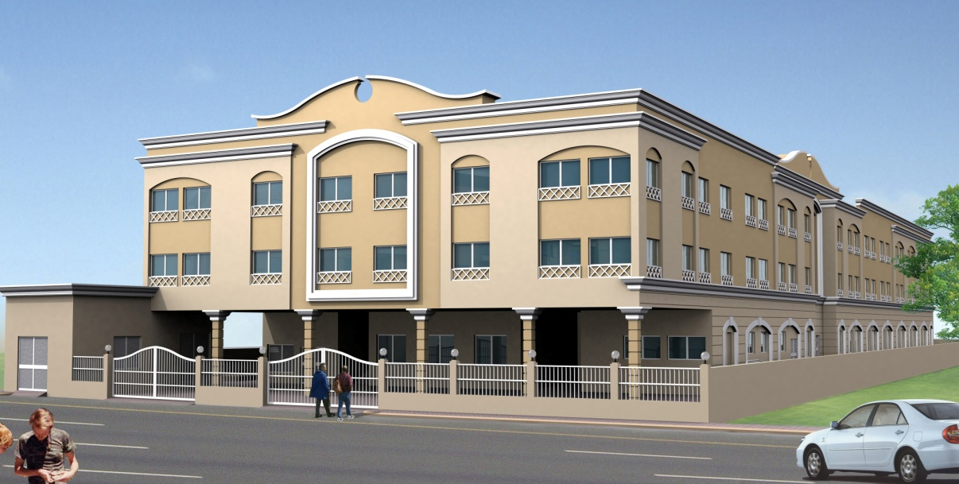
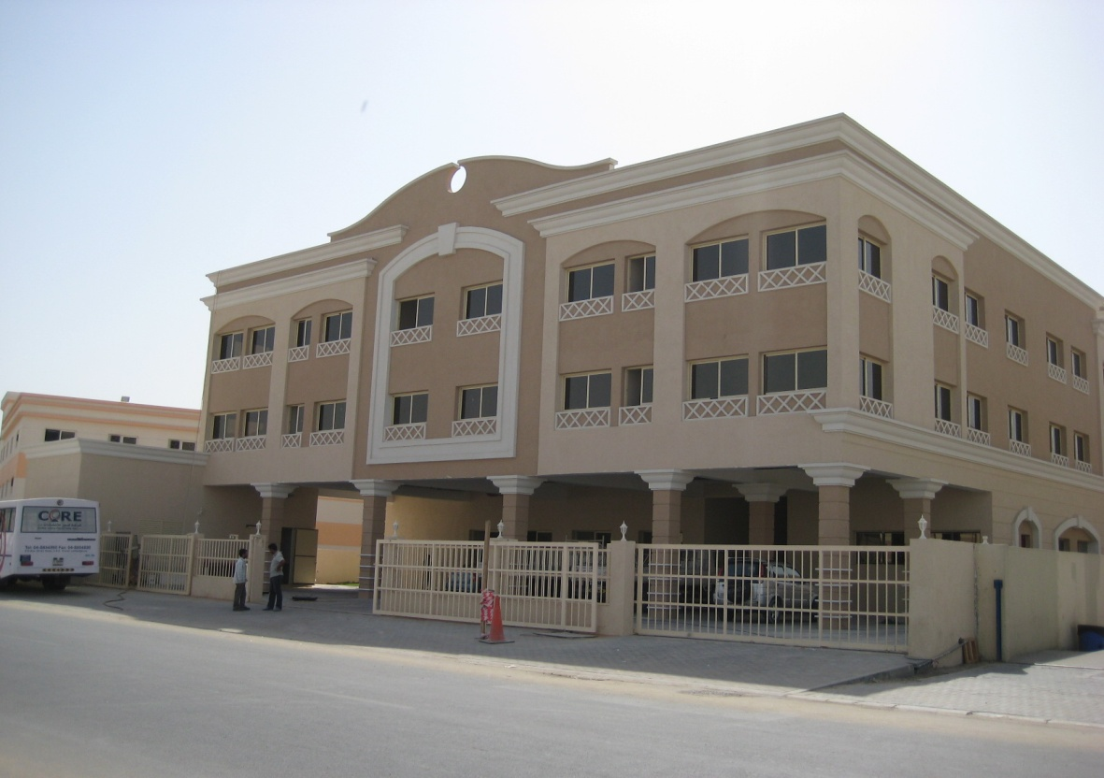
Project Photos:

Slide 31
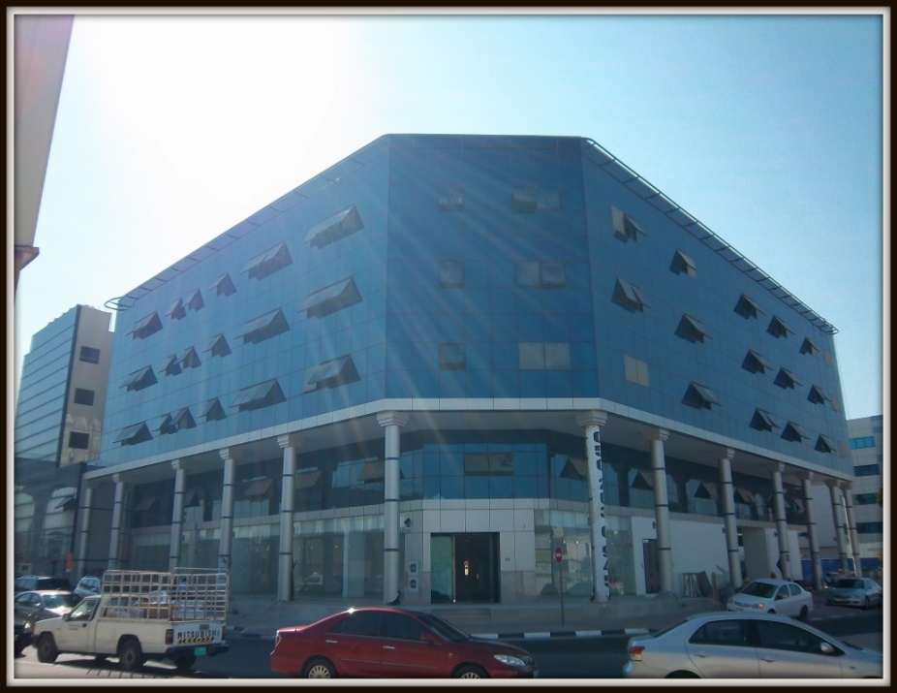
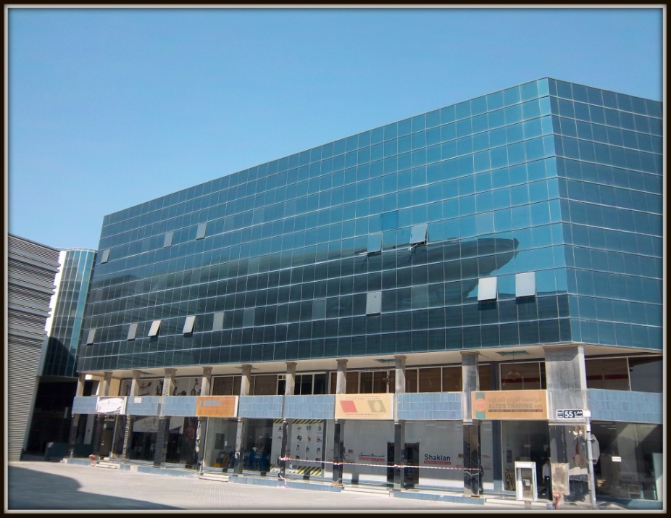
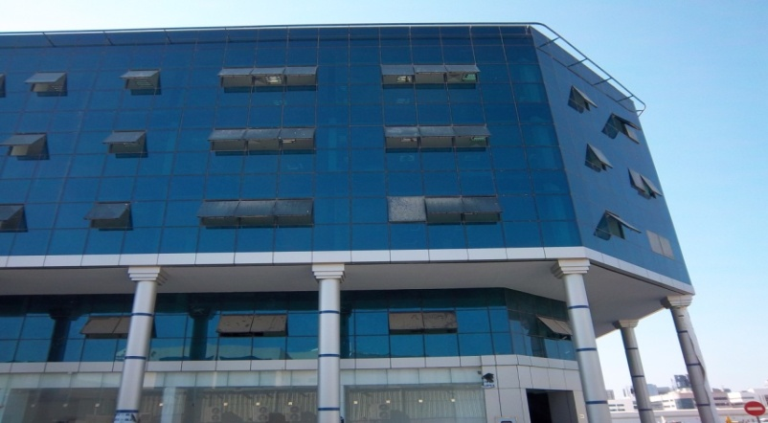
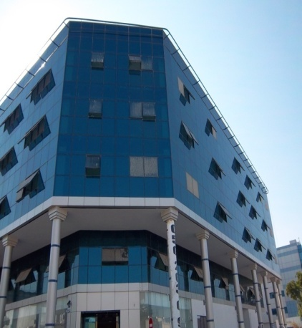
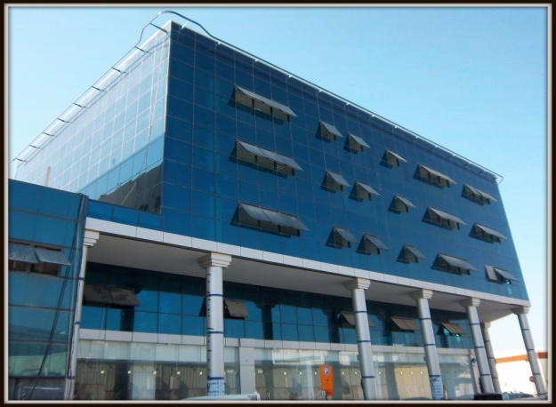
Project Photos:

Slide 32
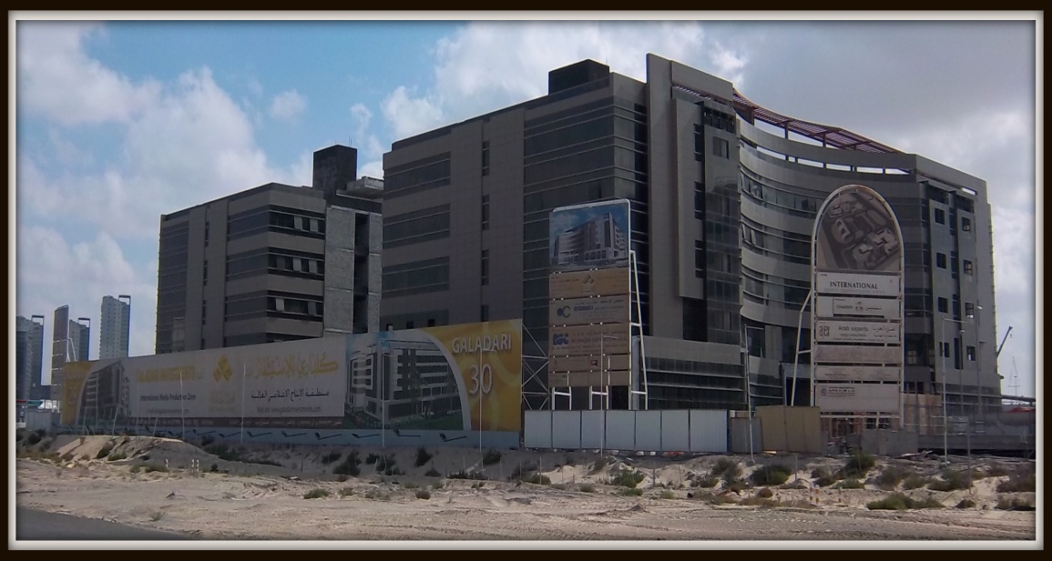

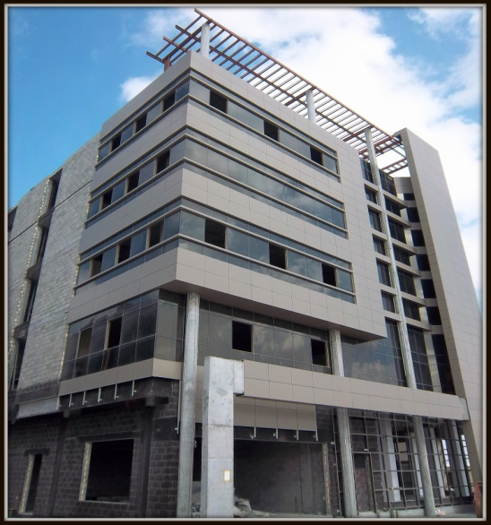

Project Photos:

Slide 33
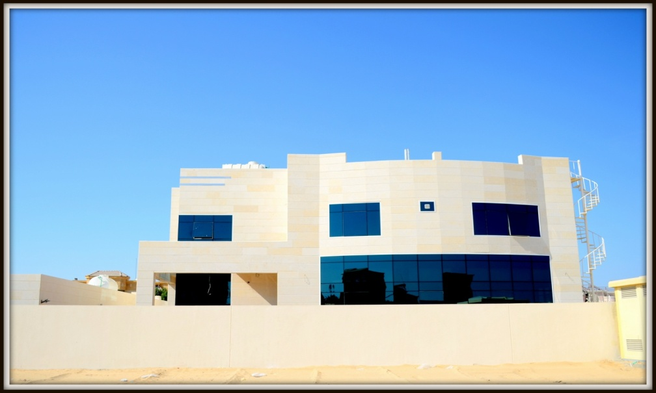
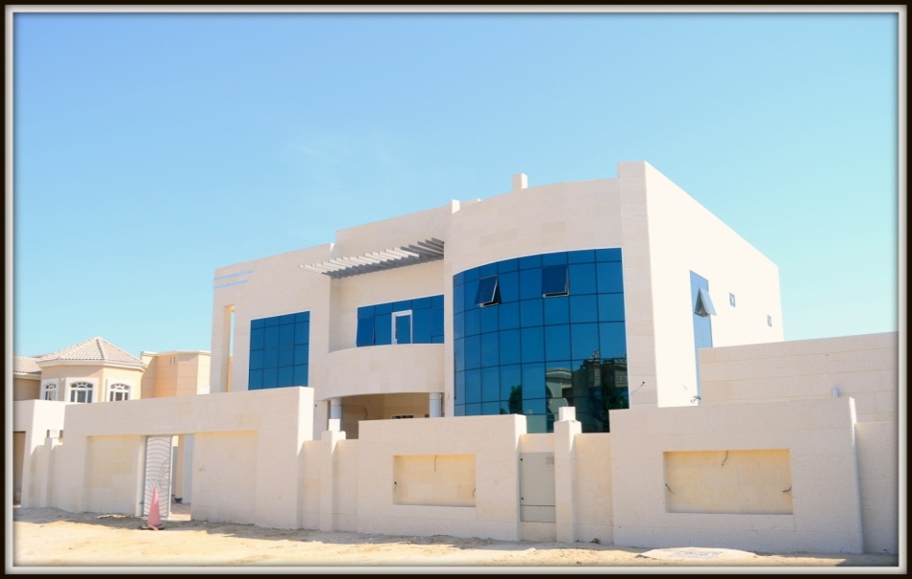
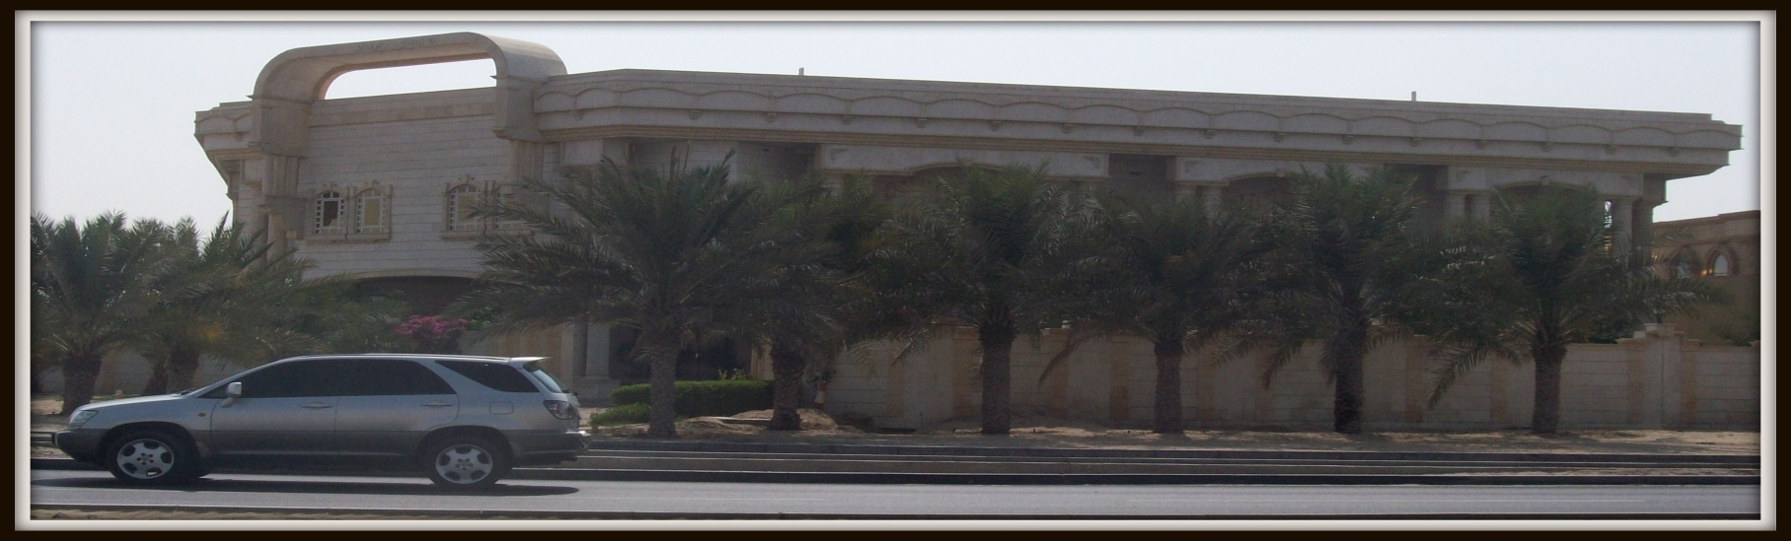
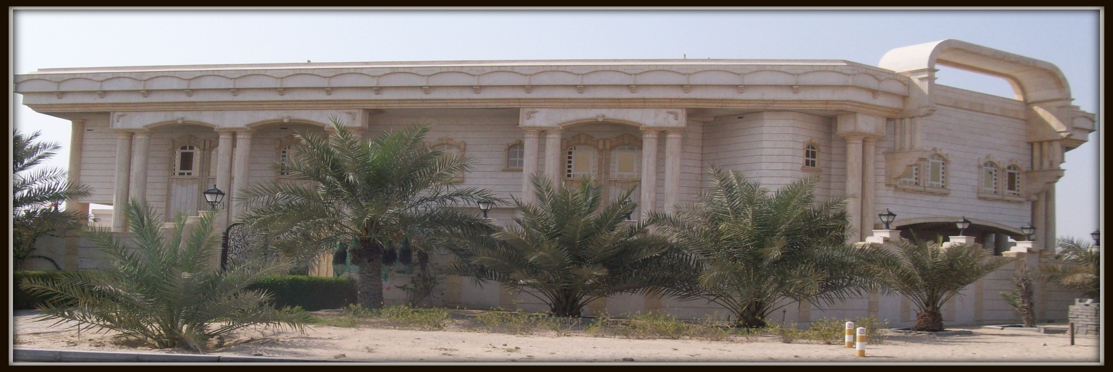
Project Photos:

Slide 34
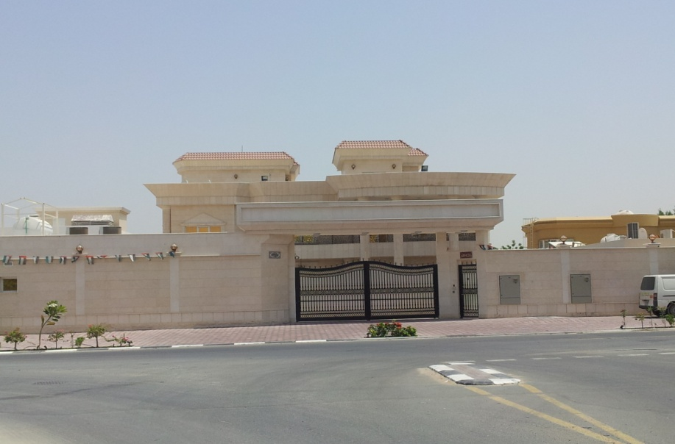
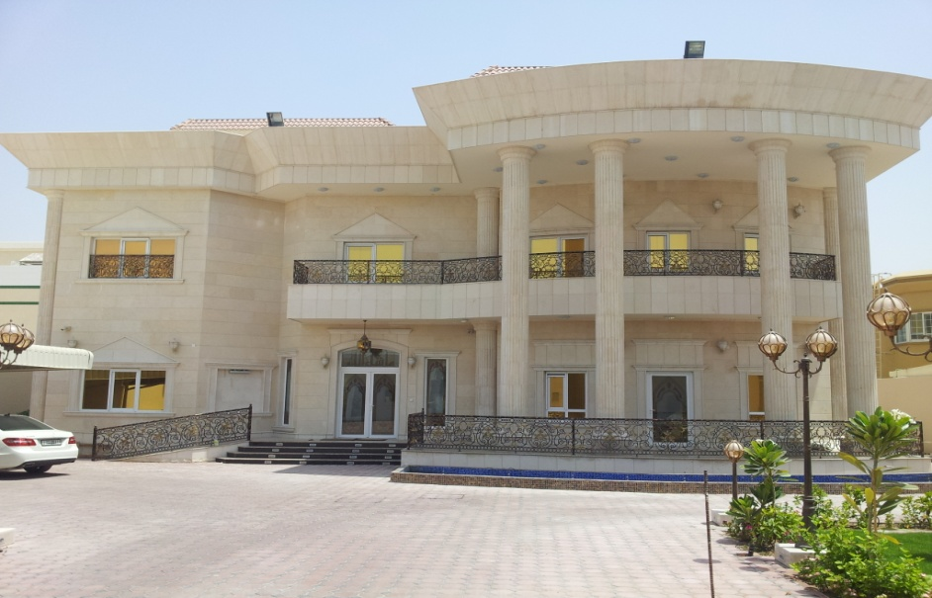
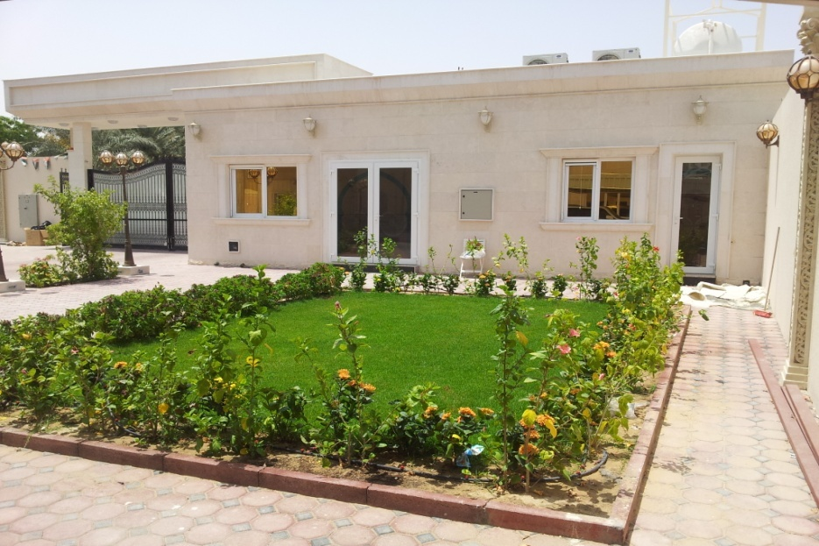
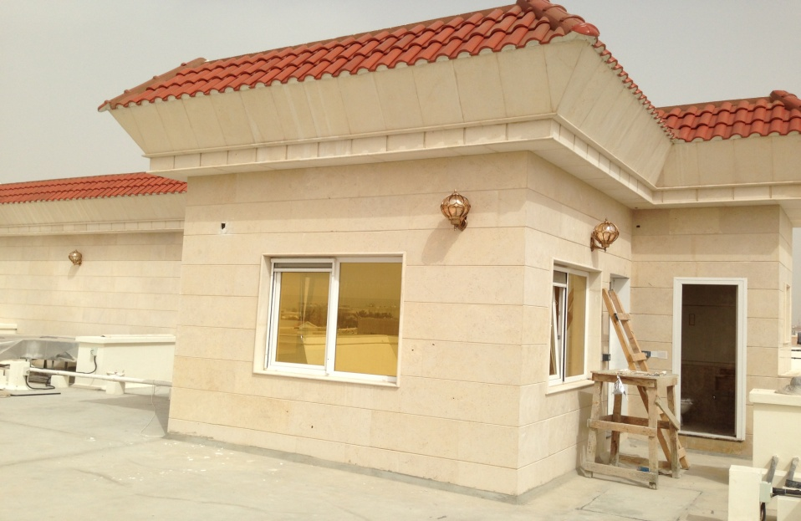
Project Photos:

Slide 35
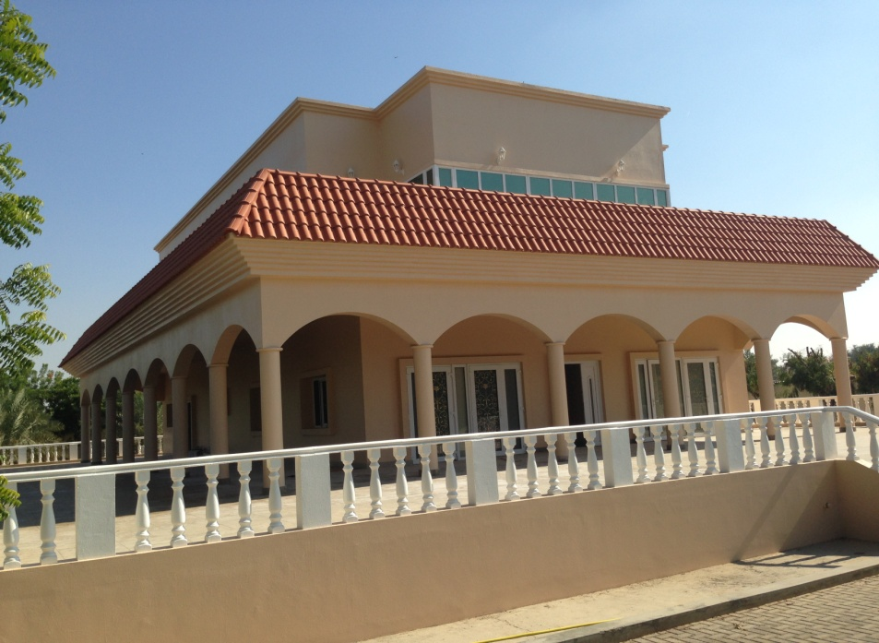
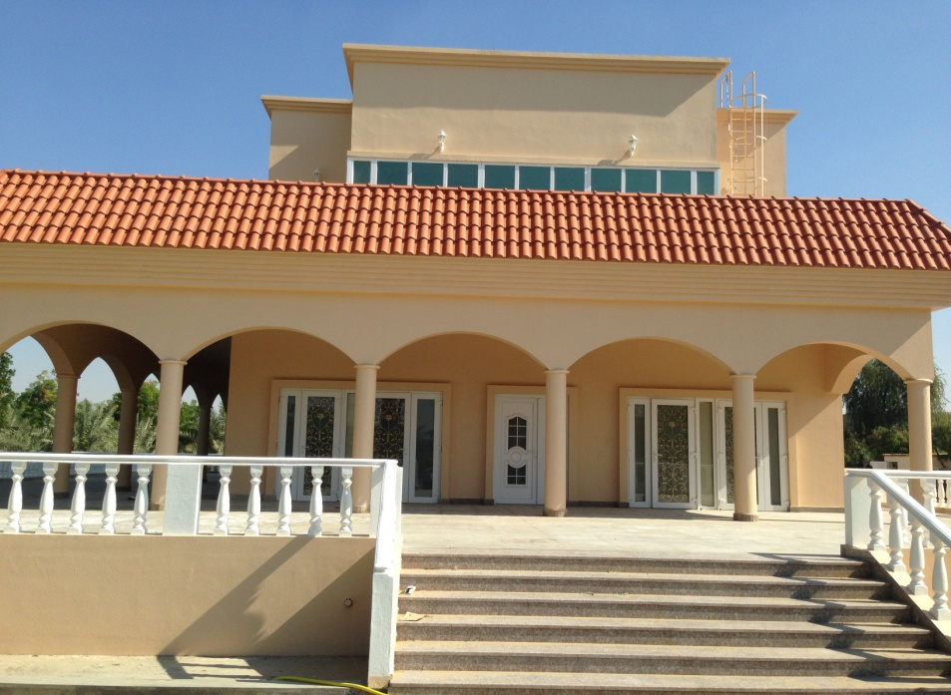
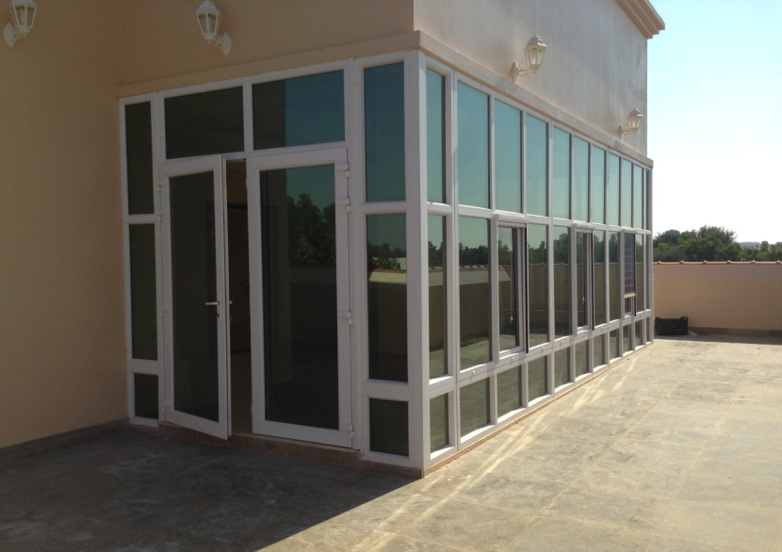
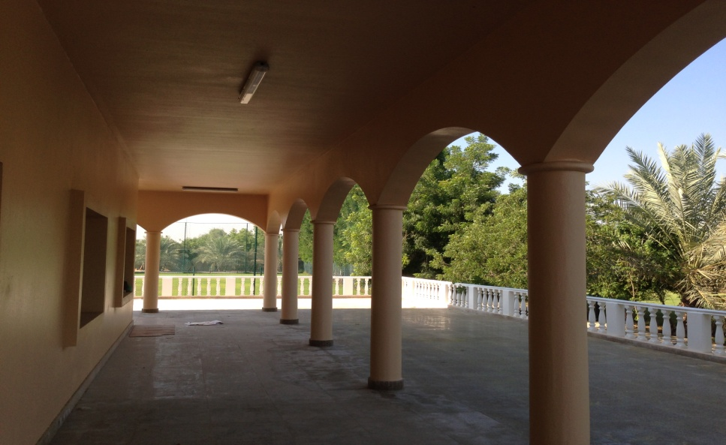
Project Photos:

Slide 36
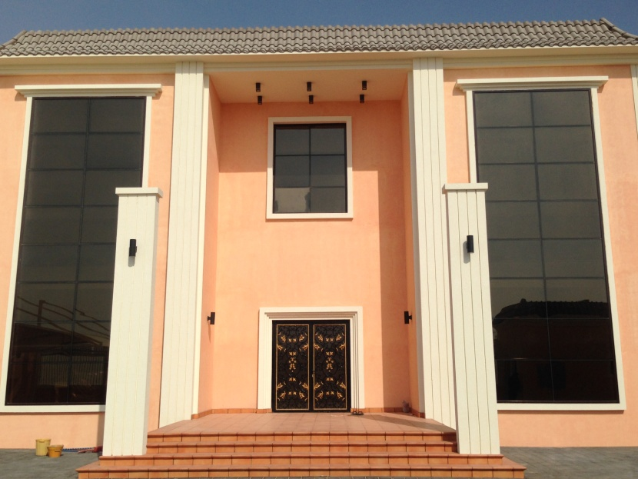
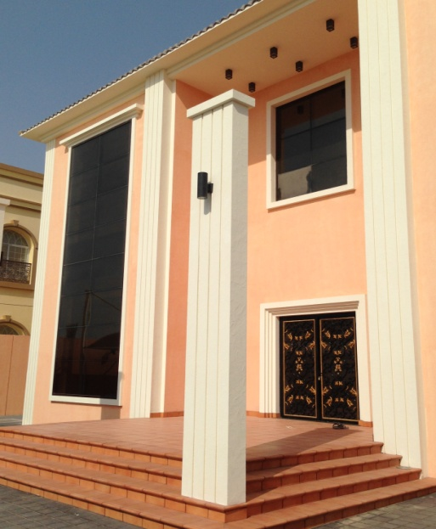
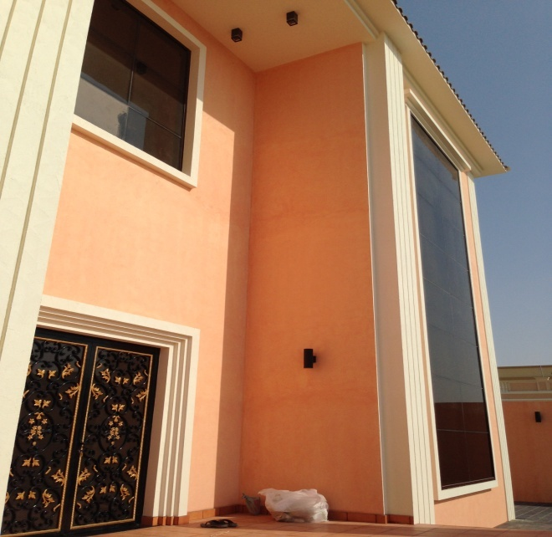
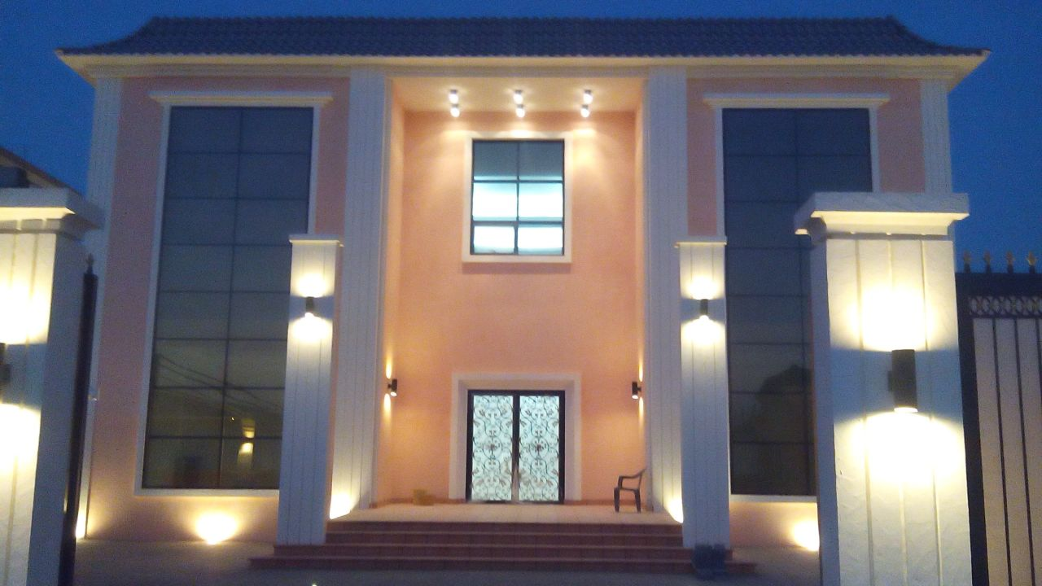
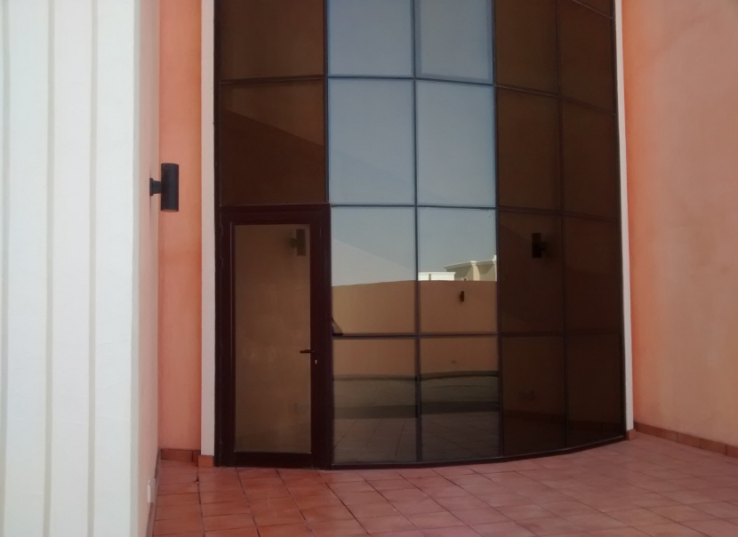
Project Photos:

Slide 37
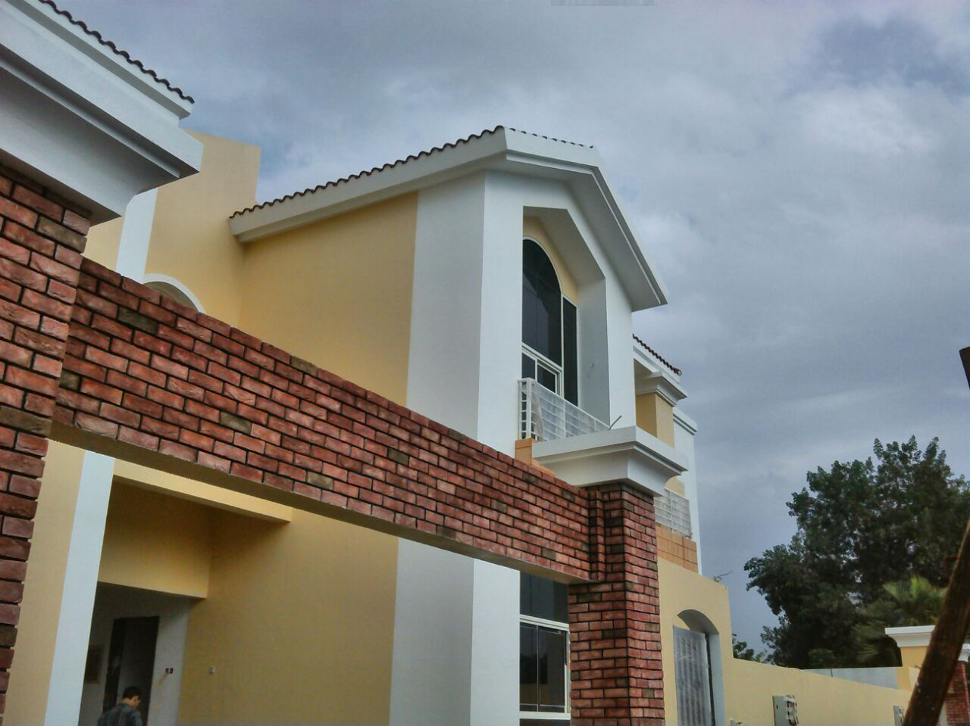
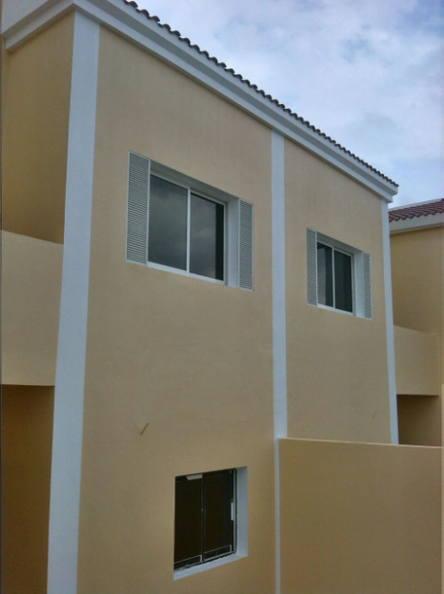
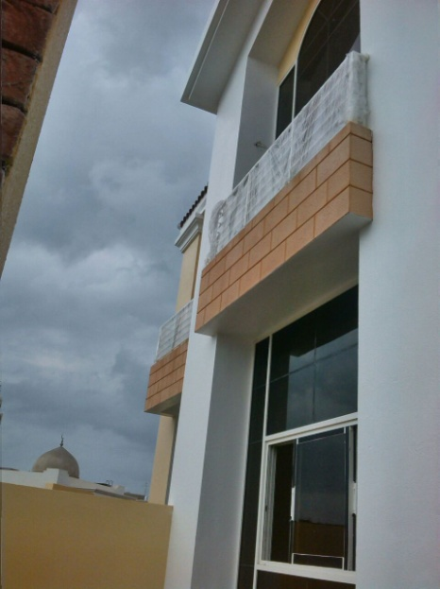
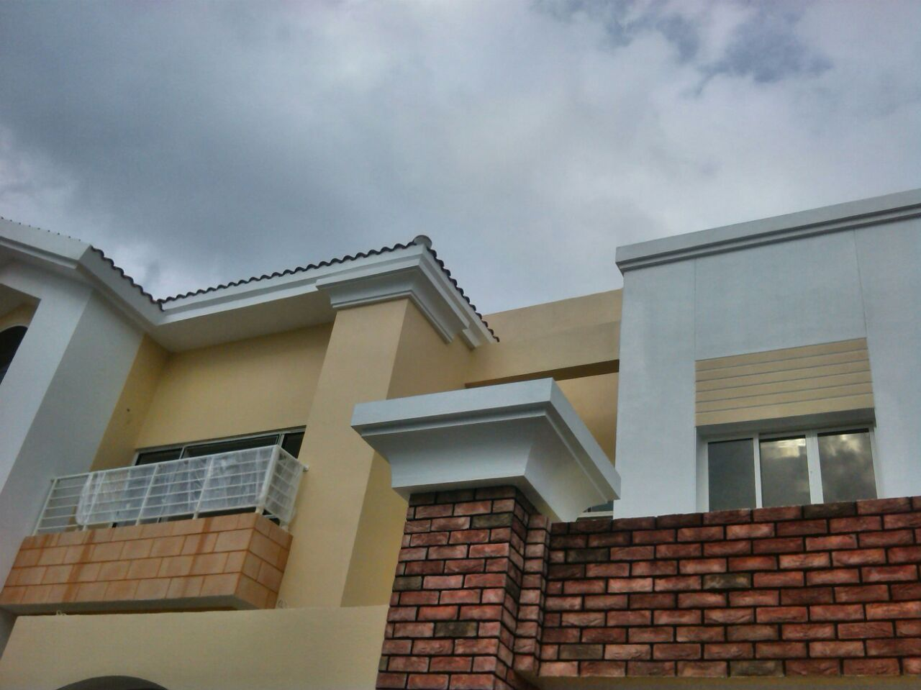
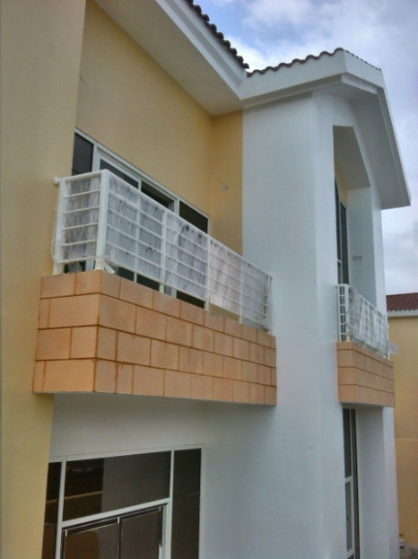
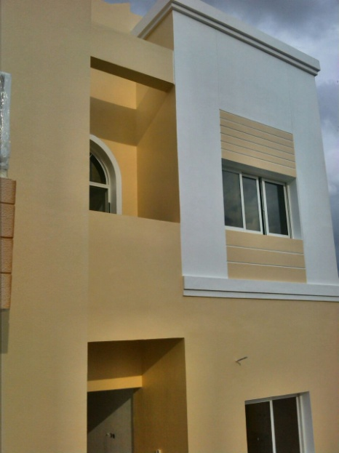
Project Photos:

Slide 38
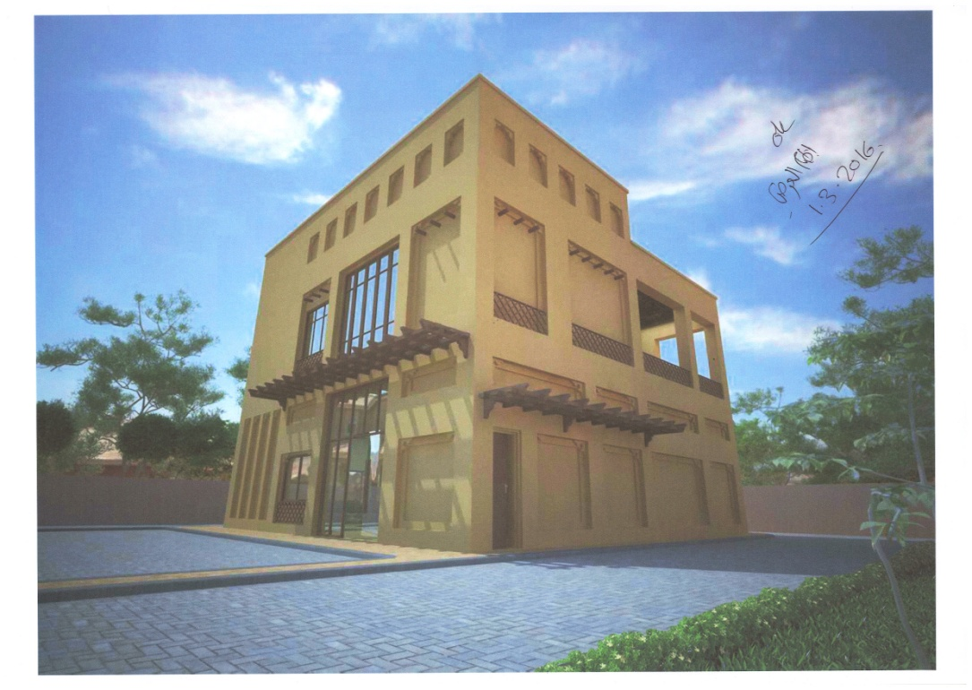
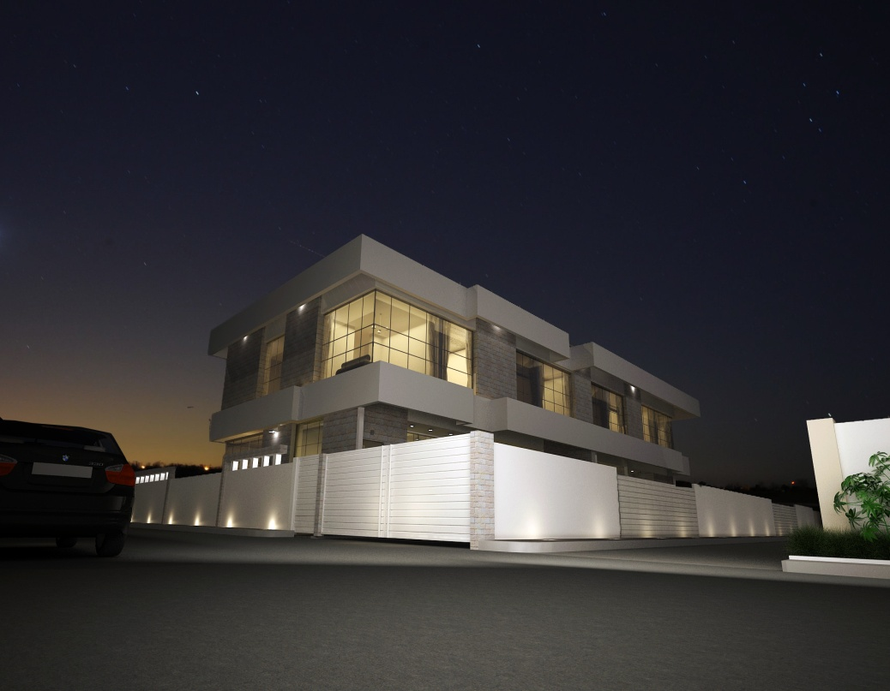
Project Photos:

Slide 39
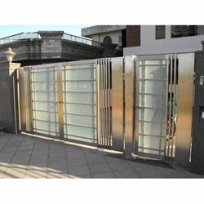
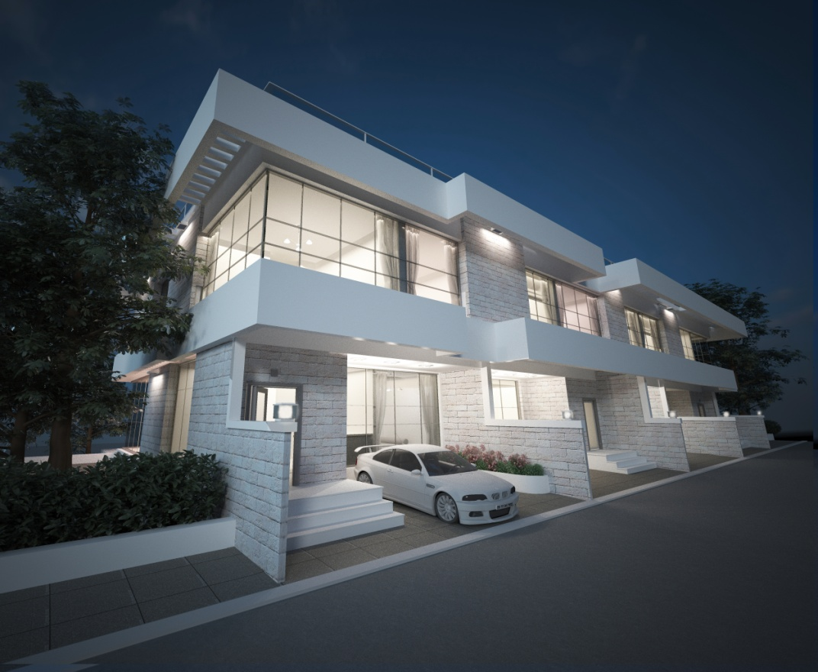
Project Photos:

Slide 40
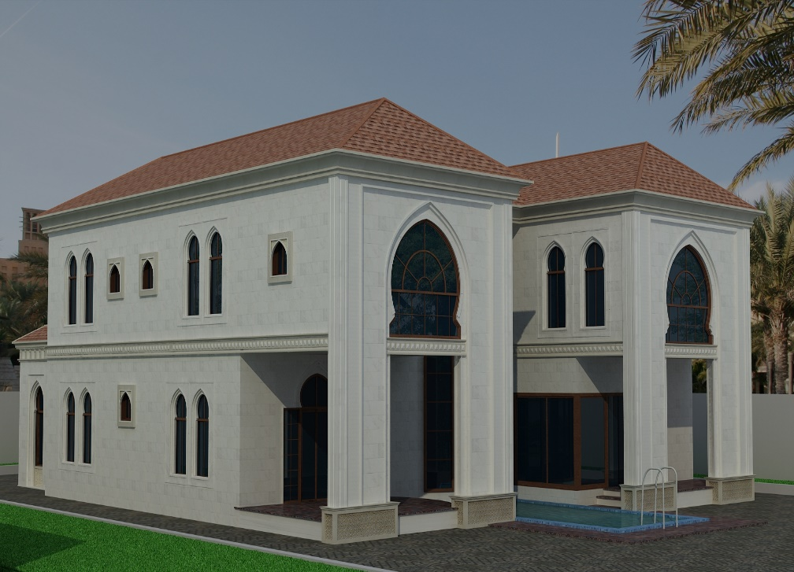
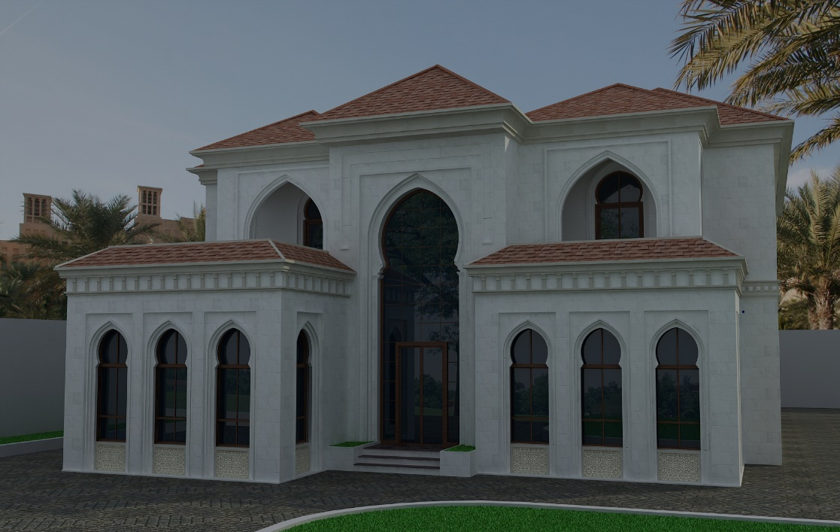
Project Photos:

Slide 41
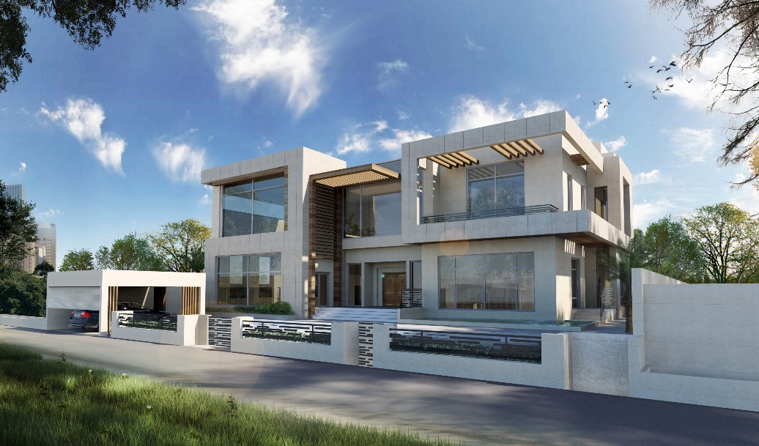
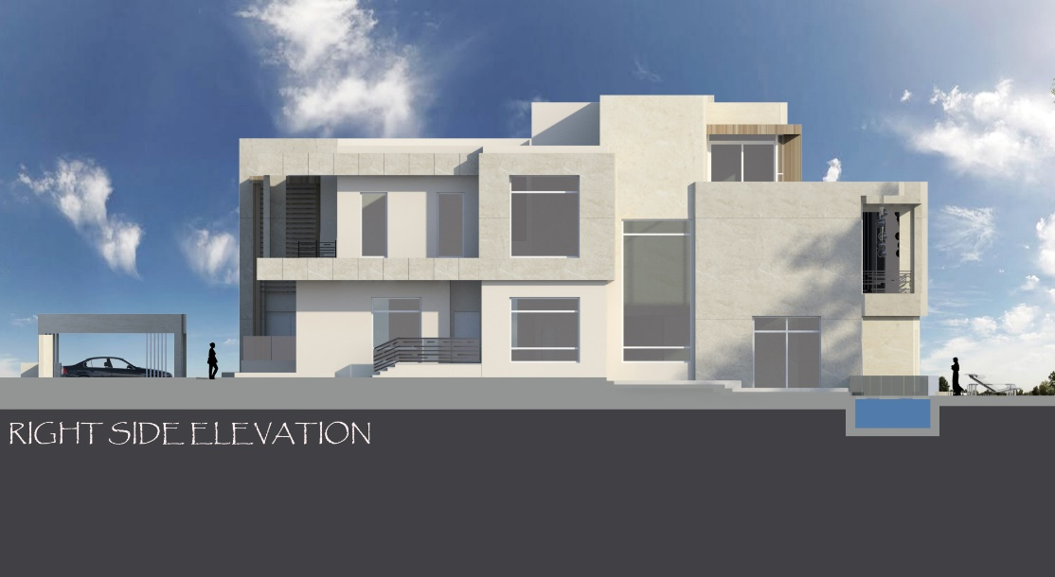
Project Photos:

Slide 42
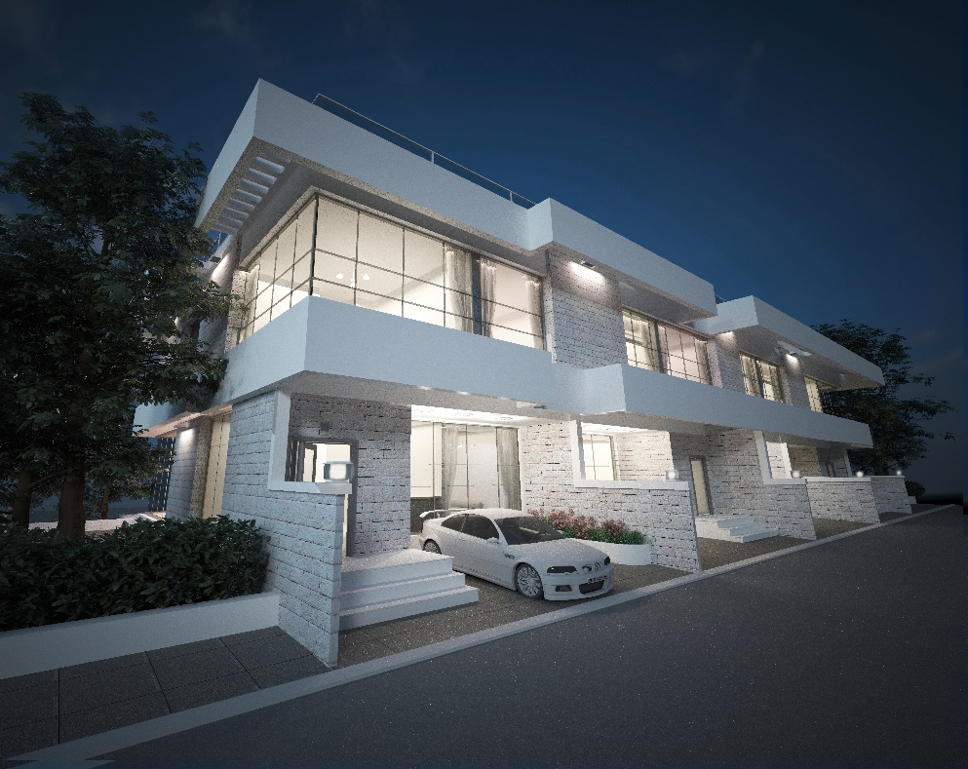

Project Photos:

Slide 43
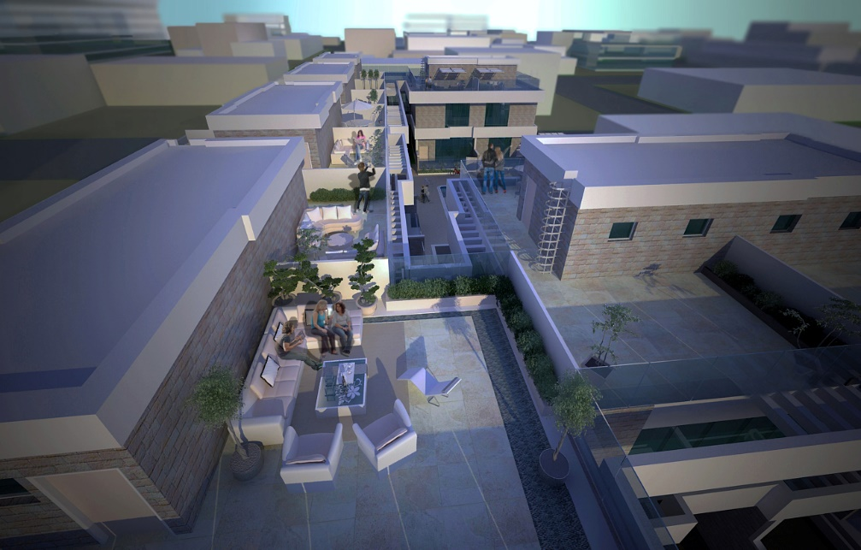
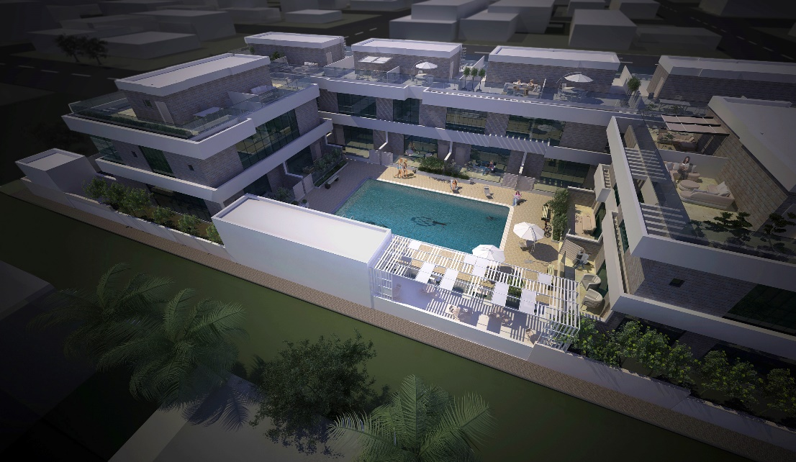
Project Photos:

Slide 44
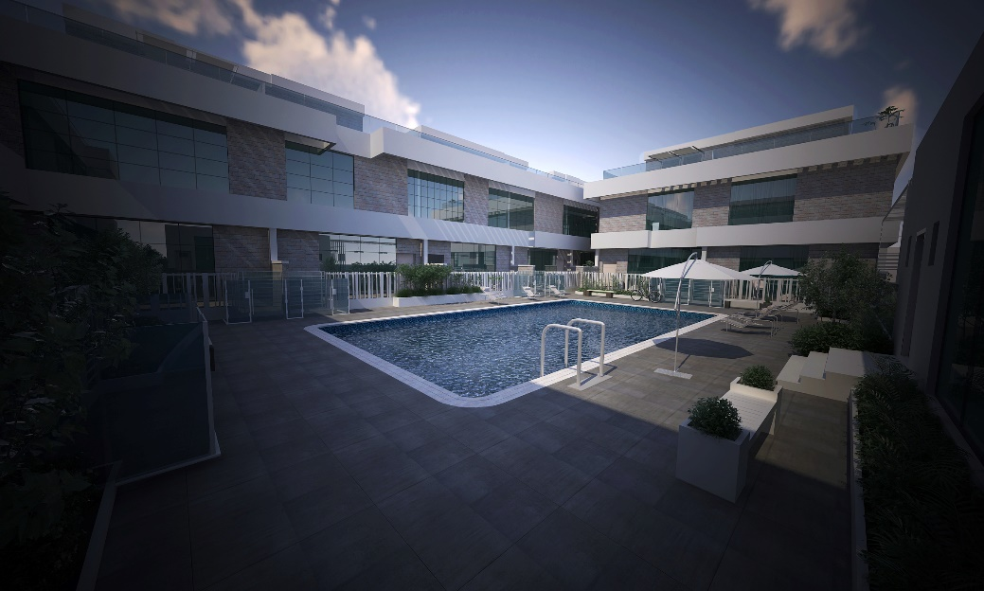
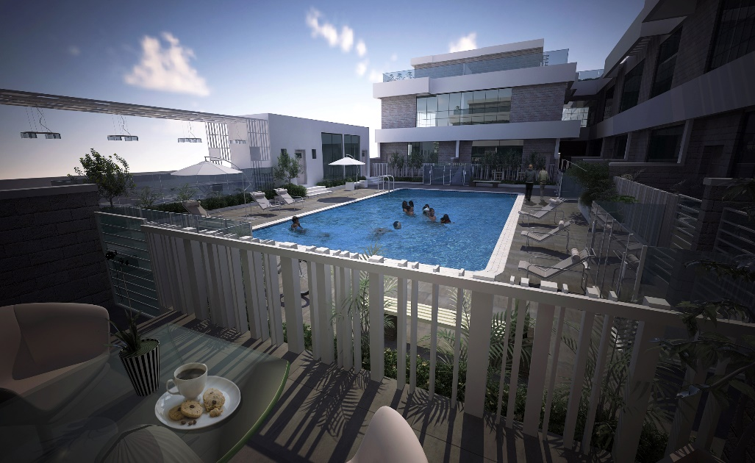


Project Photos:

Slide 45


Project Photos:

Slide 46


Project Photos:

Slide 47



Project Photos:

Slide 48


Project Photos:

Slide 49

Project Photos:

